Slide 1
Experiment-5

Slide 2
Containerizing application using Docker Container

Slide 3


Prepared By
Bhuvnesh Sanathra
Semester-7

Slide 4

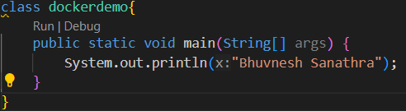
How to Containerizing application using Docker Container?
Create one Java application and compile it with javac

Slide 5
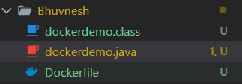
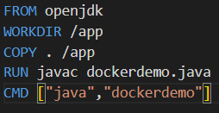
How to Containerizing application using Docker Container?
Create one DockerFile application

Slide 6
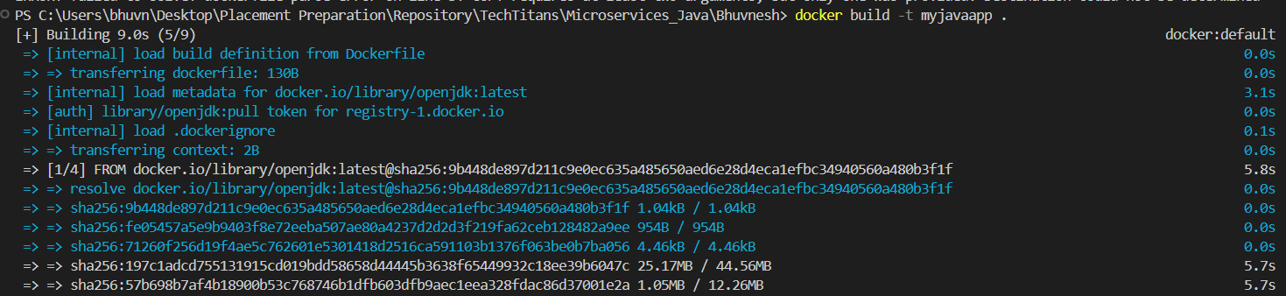
How to Containerizing application using Docker Container?
Create image using DockerFile
# docker build –t myjavaapp .

Slide 7
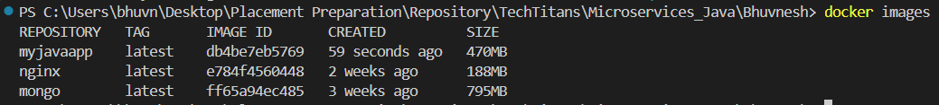
How to Containerizing application using Docker Container?
Check image
# docker images

Slide 8
How to Containerizing application using Docker Container?
Run it
# docker run --name java1 myjavaapp

Slide 9
How to Containerizing application using Docker Container?
Check container
# docker ps -a

Slide 10
Thank You

